Slide 1
Lecture 9 - Clustering

Slide 2
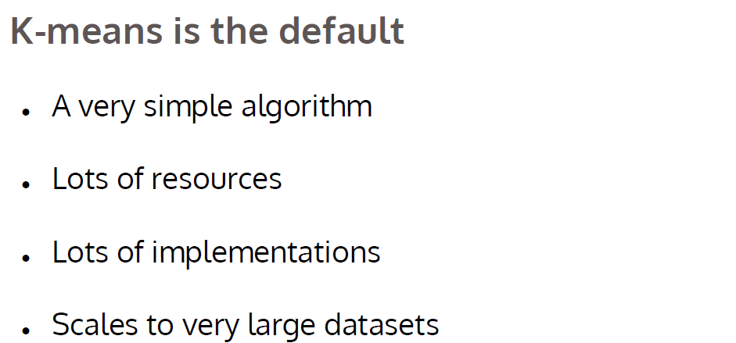

Slide 3
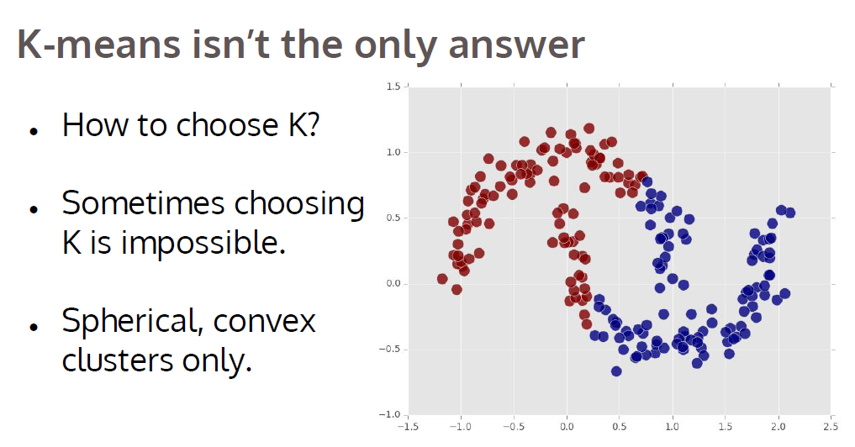

Slide 4
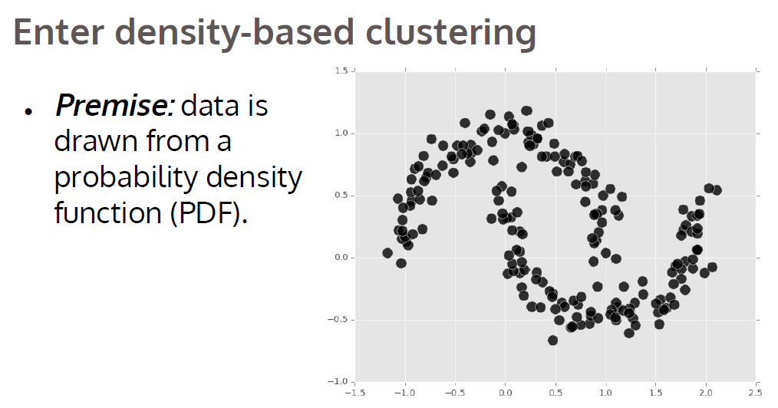

Slide 5
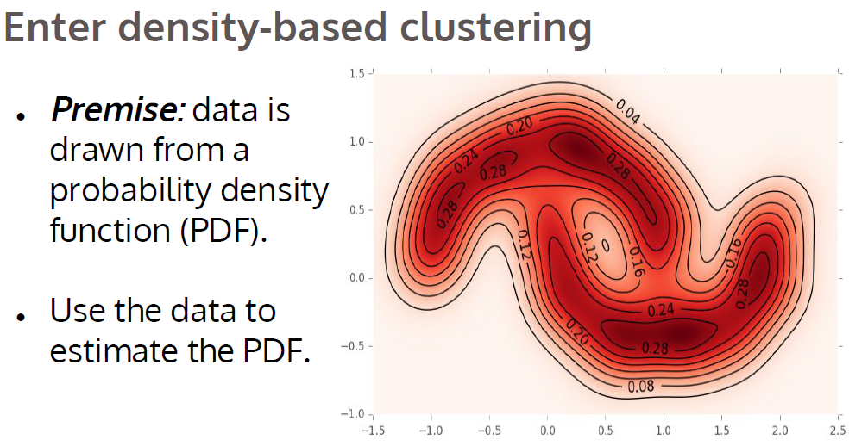

Slide 6
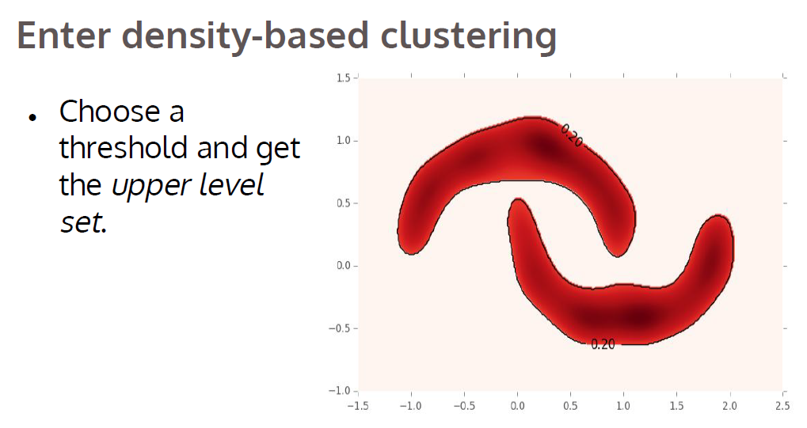

Slide 7
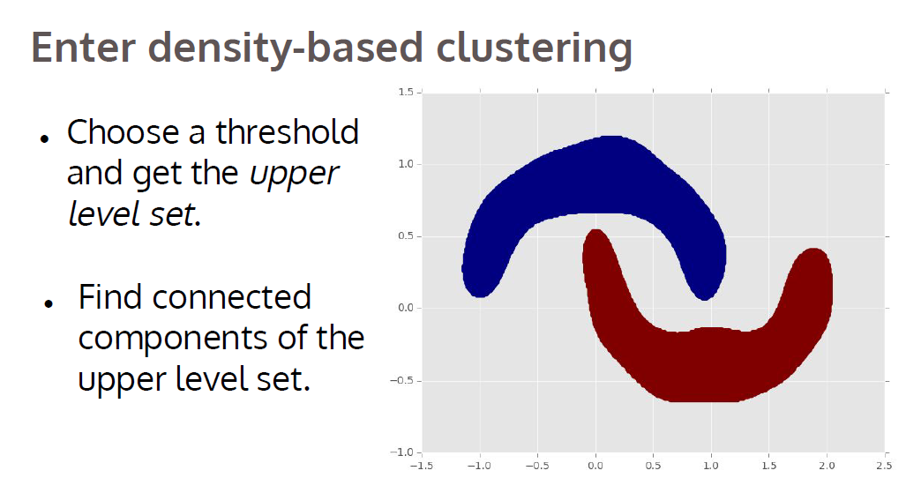

Slide 8
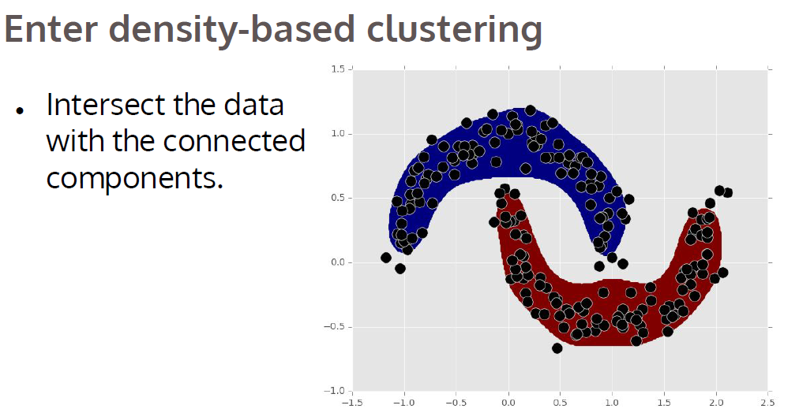

Slide 9
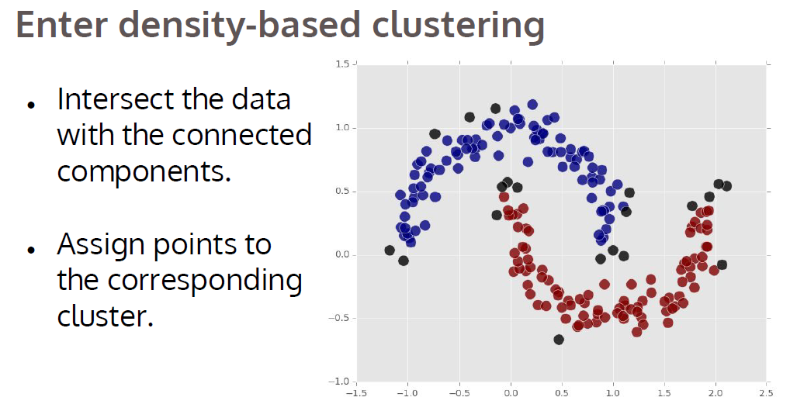

Slide 10
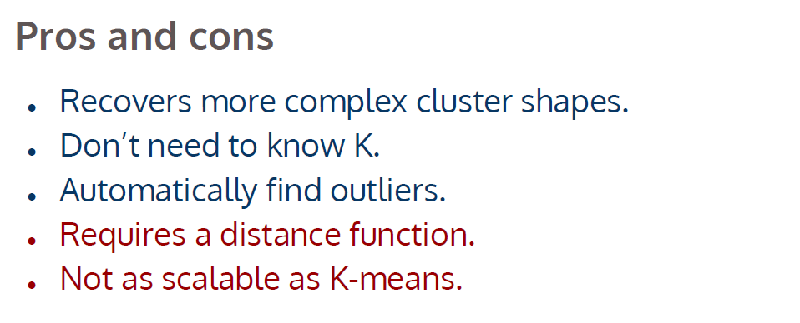

Slide 11
DBScan

Slide 12
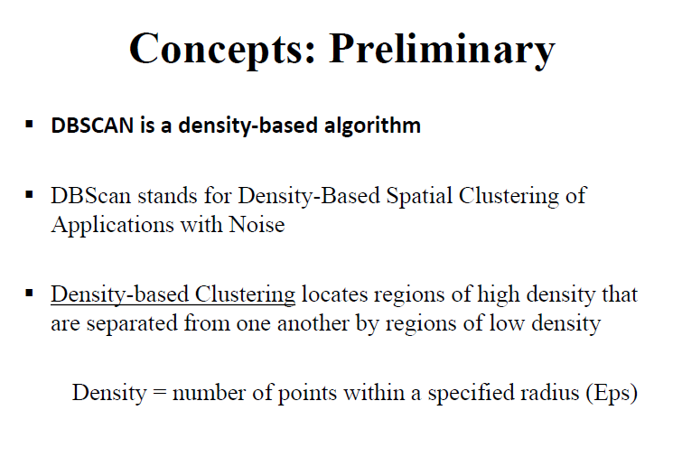

Slide 13
ε-Neighborhood
ε-Neighborhood – Objects within a radius of ε from an object.
“High density” - ε-Neighborhood of an object contains at least MinPts of objects.
ε-Neighborhood of p
ε
ε
ε-Neighborhood of q
q
p
Density of p is “high” (MinPts = 4)
Density of q is “low” (MinPts = 4)

Slide 14
Core, Border & Outlier
Outlier
Given ε and MinPts, categorize the objects into three exclusive groups.
Border
A point is a core point if it has more than a specified number of points (MinPts) within Eps These are points that are at the interior of a cluster.
A border point has fewer than MinPts within Eps, but is in the neighborhood of a core point.
A noise point is any point that is not a core point nor a border point.
Core
ε = 1unit, MinPts = 5

Slide 15
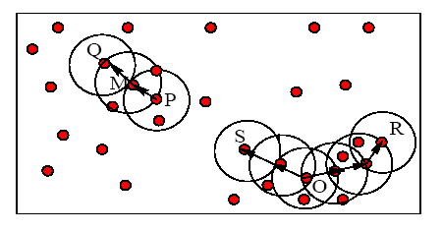
Example
M, P, O, and R are core objects since each is in an Eps neighborhood containing at least 3 points
Minpts = 3
Eps=radius of the circles

Slide 16
Density-Reachability
Directly density-reachable
An object q is directly density-reachable from object p if p is a core object and q is in p’s ε-neighborhood.
q is directly density-reachable from p
p is not directly density- reachable from q
Density-reachability is asymmetric.
ε
ε
q
p
MinPts = 4

Slide 17
Density-reachability
Density-Reachable (directly and indirectly):
A point p is directly density-reachable from p2;
p2 is directly density-reachable from p1;
p1 is directly density-reachable from q;
p←p2←p1←q form a chain.
p
p is (indirectly) density-reachable from q
q is not density- reachable from p
p₂
p₁
q
MinPts = 7

Slide 18
Density-Connectivity
Density-reachable is not symmetric
not good enough to describe clusters
Density-Connected
A pair of points p and q are density-connected if they are commonly density-reachable from a point o.
Density-connectivity is symmetric
p
q
o

Slide 19
DBSCAN: The Algorithm
Arbitrary select a point p
Retrieve all points density-reachable from p wrt Eps and MinPts.
If p is a core point, a cluster is formed.
If p is a border point, no points are density-reachable from p and DBSCAN visits the next point of the database.
Continue the process until all of the points have been processed.
The points that don’t belong to any cluster are the outliers

Slide 20
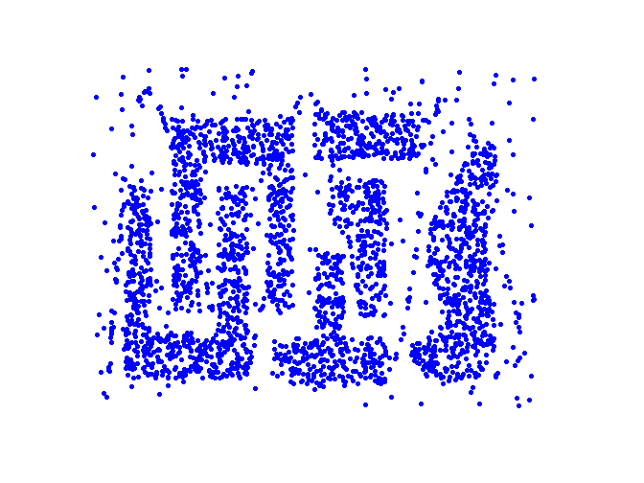
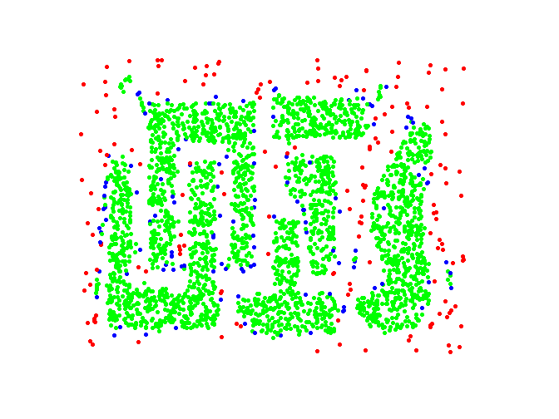
Example
Original Points
Point types: core, border and outliers
ε = 10, MinPts = 4

Slide 21
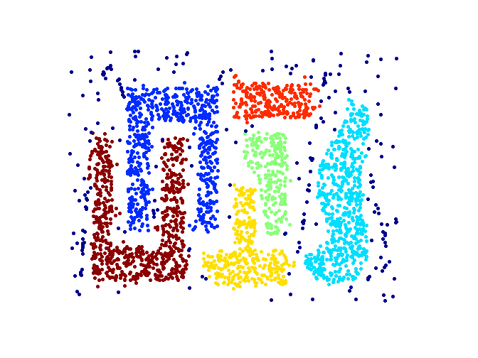
When DBSCAN Works Well
Original Points
Clusters
Resistant to Noise
Can handle clusters of different shapes and sizes

Slide 22
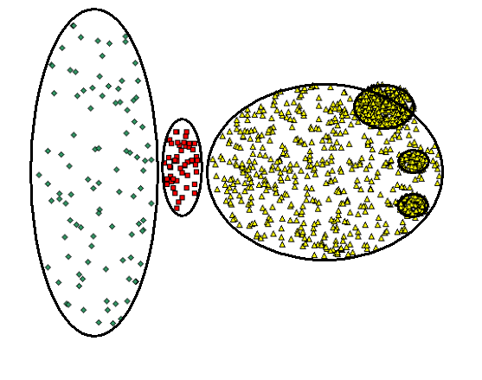
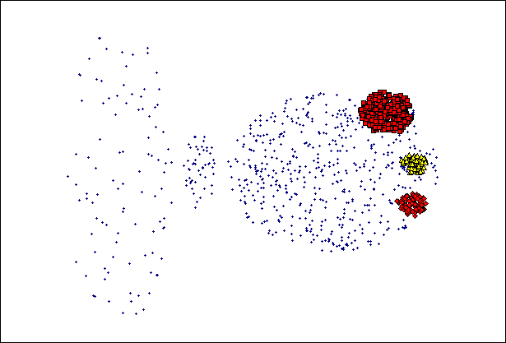
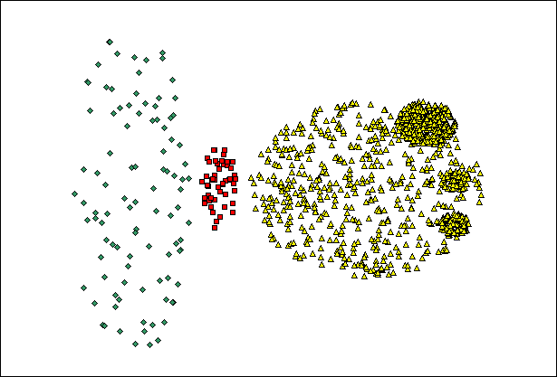
When DBSCAN Does NOT Work Well
(MinPts=4, Eps=9.92).
Original Points
Cannot handle Varying densities
sensitive to parameters
(MinPts=4, Eps=9.75)

Slide 23
Determining the Parameters ε and MinPts
Cluster: Point density higher than specified by ε and MinPts
Idea: use the point density of the least dense cluster in the data set as parameters – but how to determine this?
Heuristic: look at the distances to the k-nearest neighbors
Function k-distance(p): distance from p to the its k-nearest neighbor
k-distance plot: k-distances of all objects, sorted in decreasing order
p
3-distance(p) :
q
3-distance(q) :

Slide 24
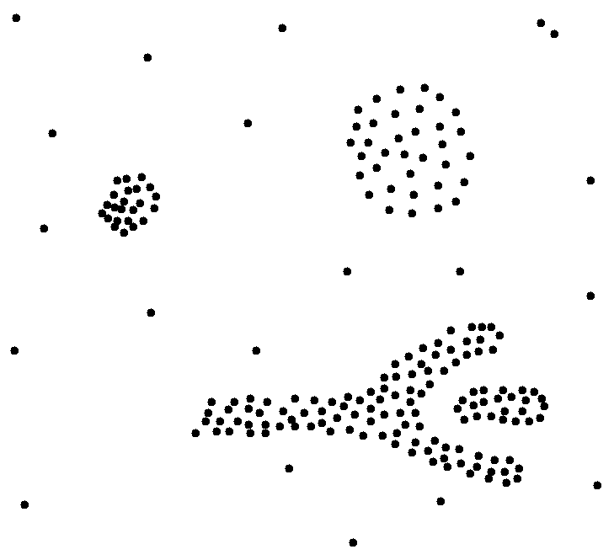
Determining the Parameters ε and MinPts
Example k-distance plot
Heuristic method:
Fix a value for MinPts (default: 2 × dimensions –1)
User selects “border object” o from the MinPts-distance plot; ε is set to MinPts-distance(o)
3-distance
first „valley“
Objects
„border object“

Slide 25
DBScan visualization
http://www.naftaliharris.com/blog/visualizing-dbscan-clustering/

Slide 26
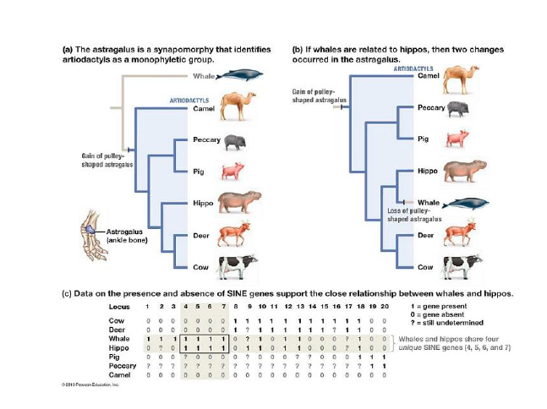
Hierarchical Clustering

Slide 27
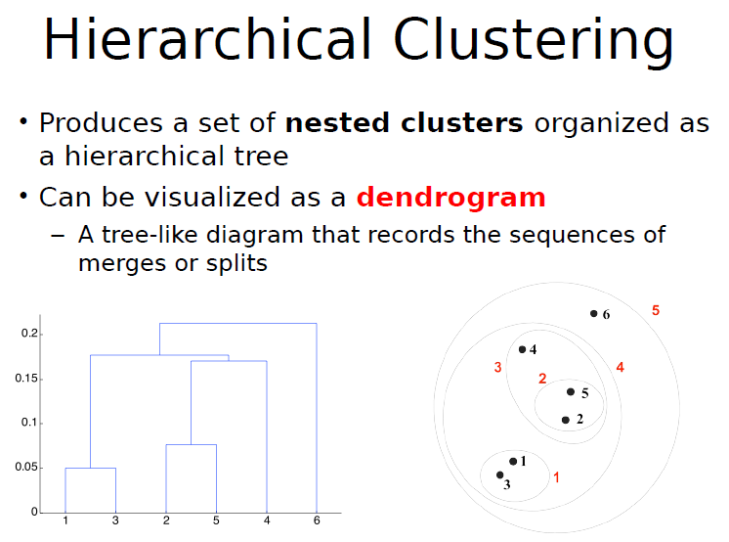

Slide 28
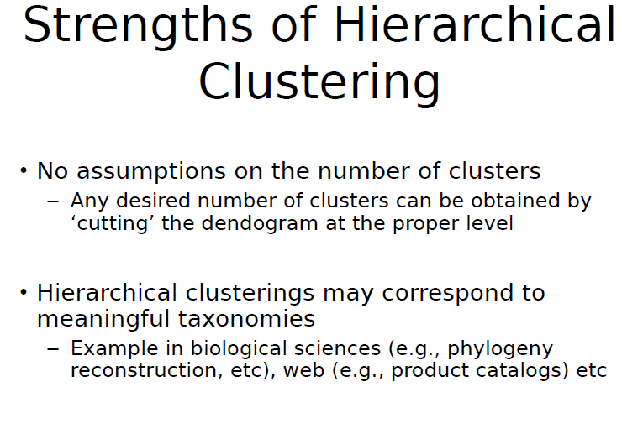

Slide 29
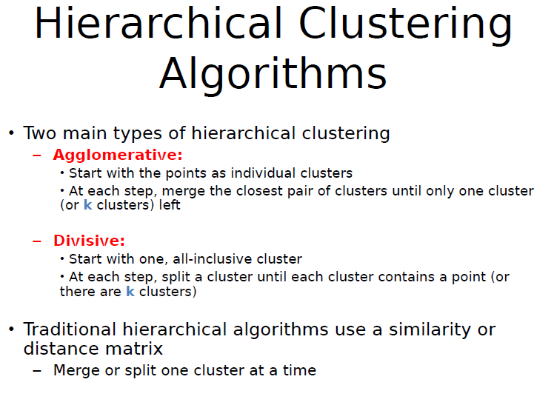

Slide 30
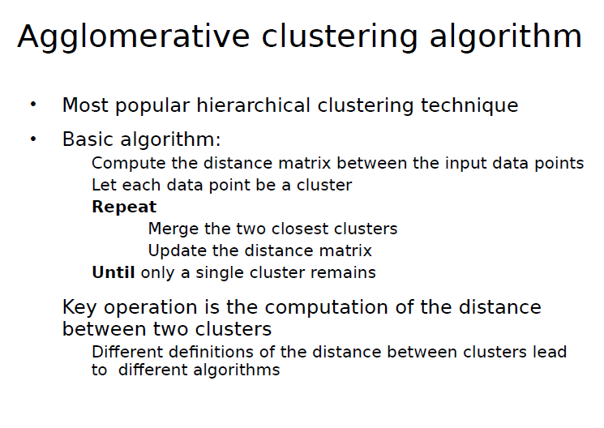

Slide 31
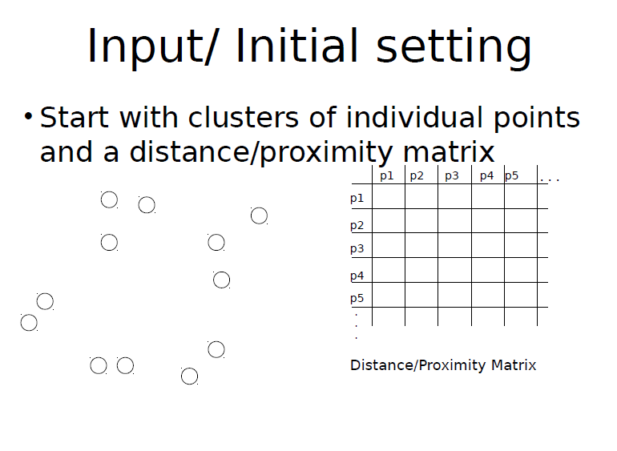

Slide 32
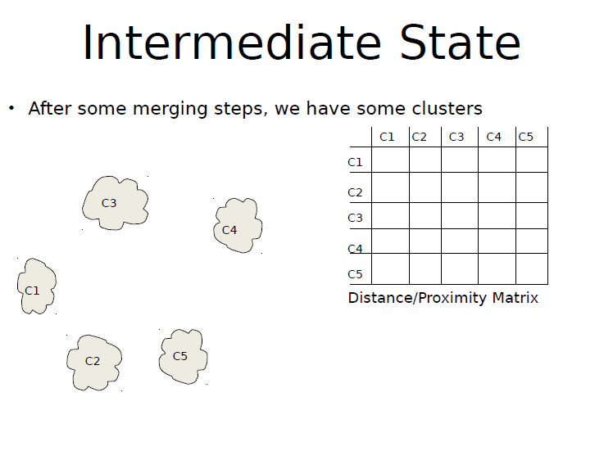

Slide 33
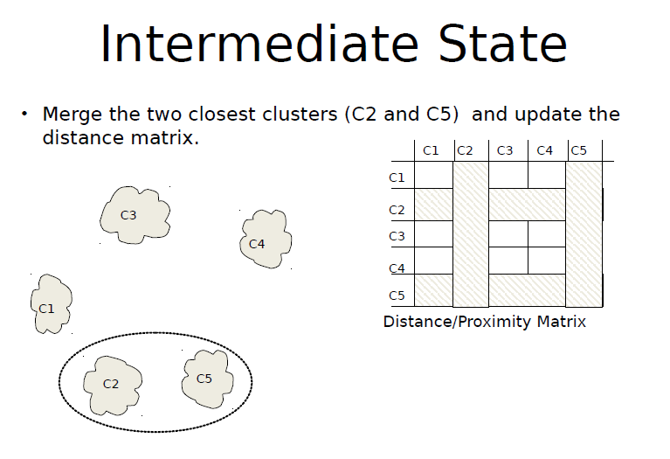

Slide 34
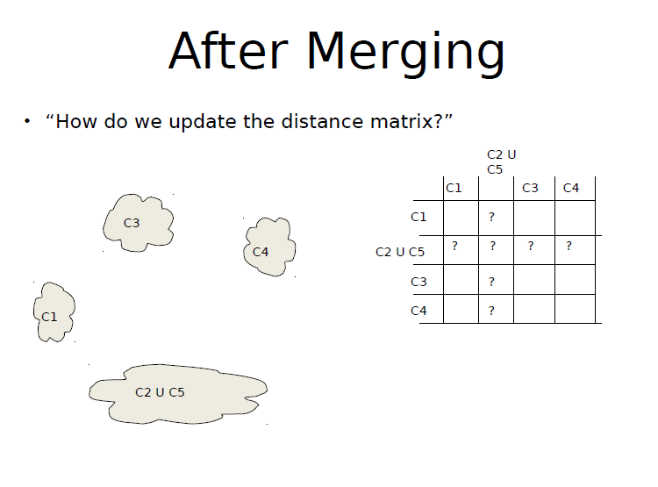

Slide 35
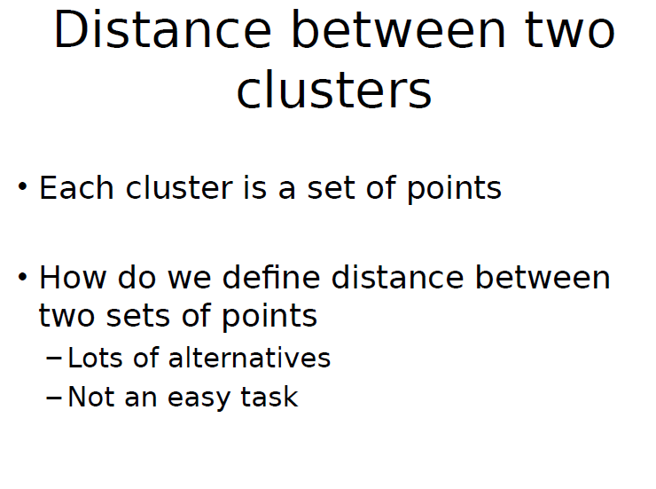

Slide 36
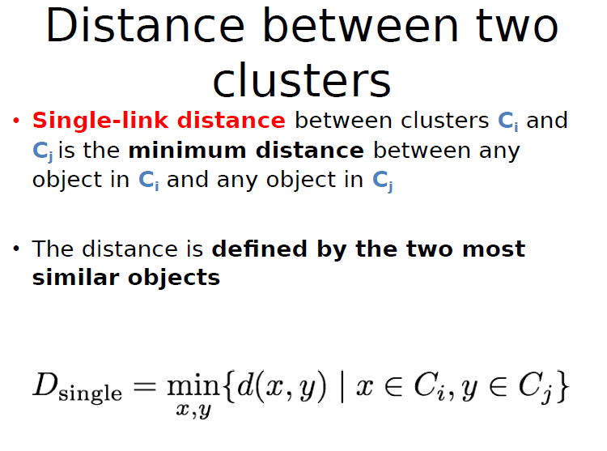

Slide 37
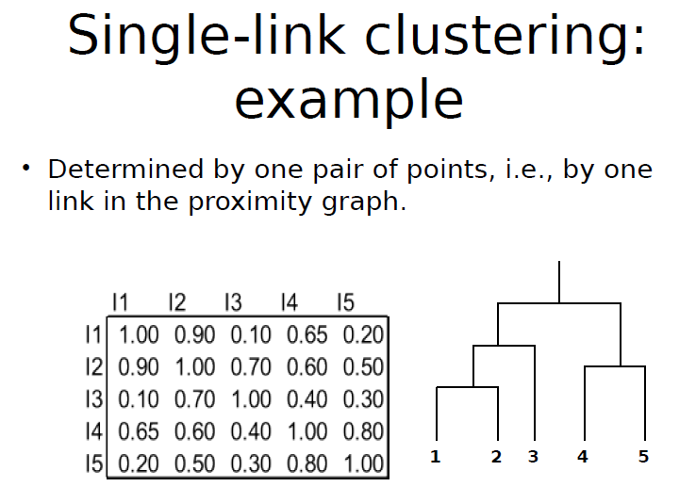

Slide 38
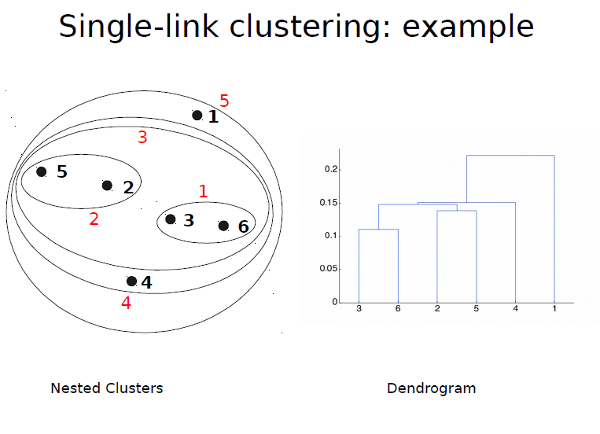

Slide 39
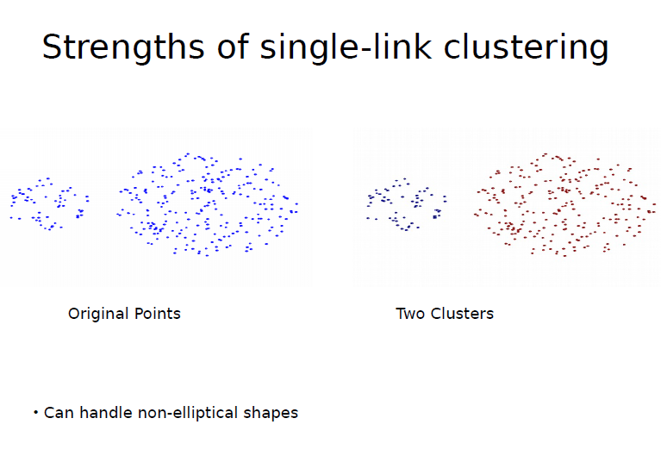

Slide 40
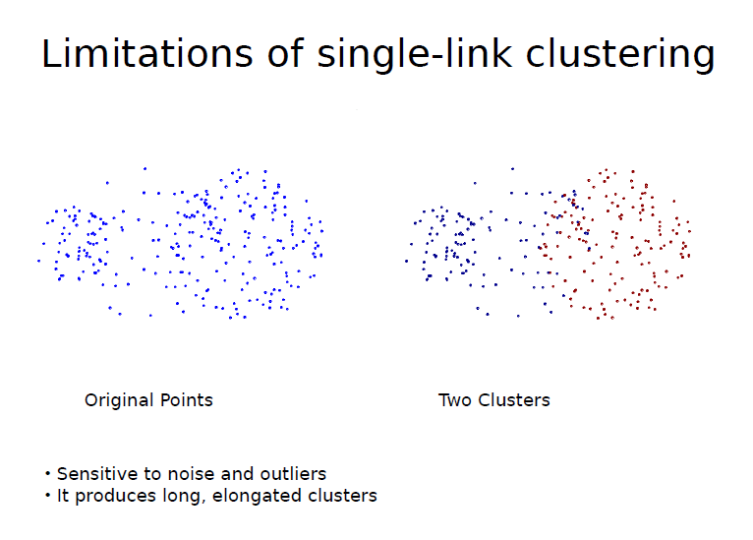

Slide 41
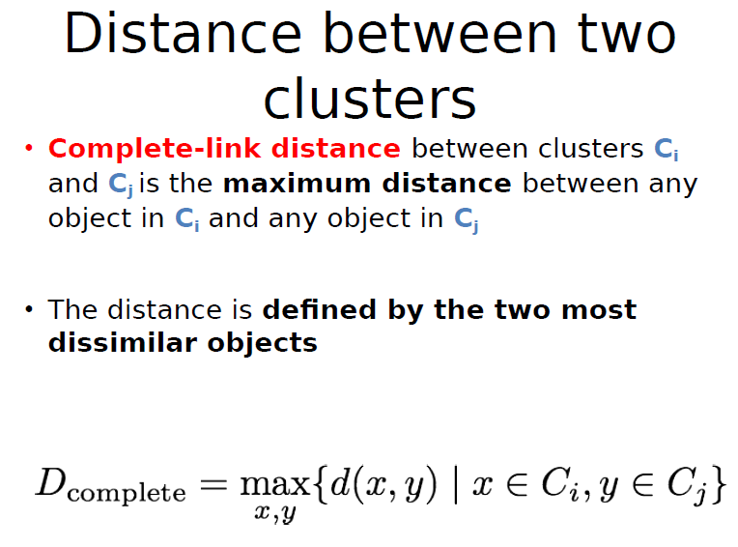

Slide 42
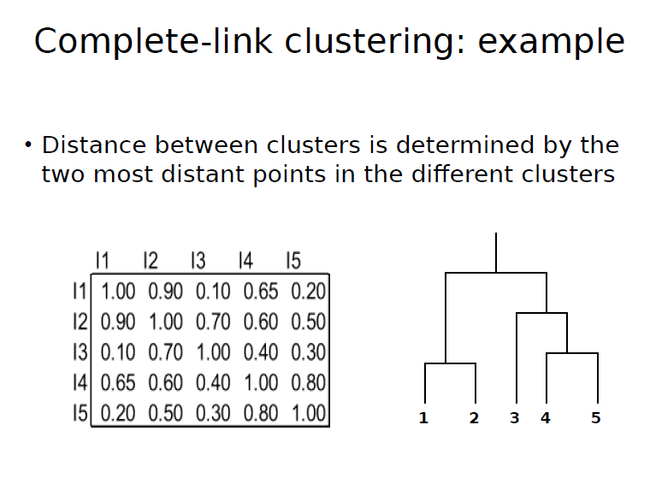

Slide 43
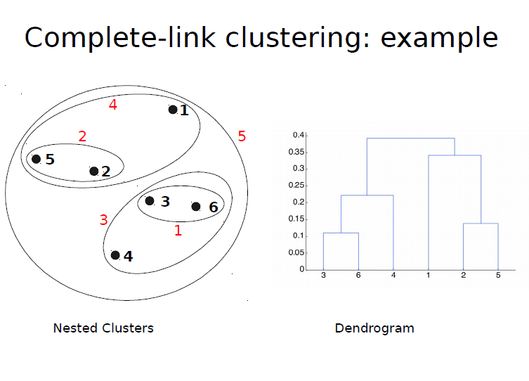

Slide 44
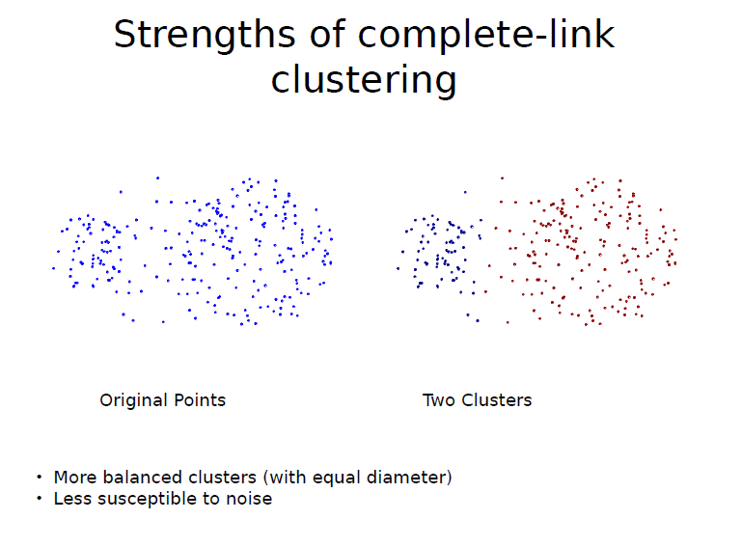

Slide 45
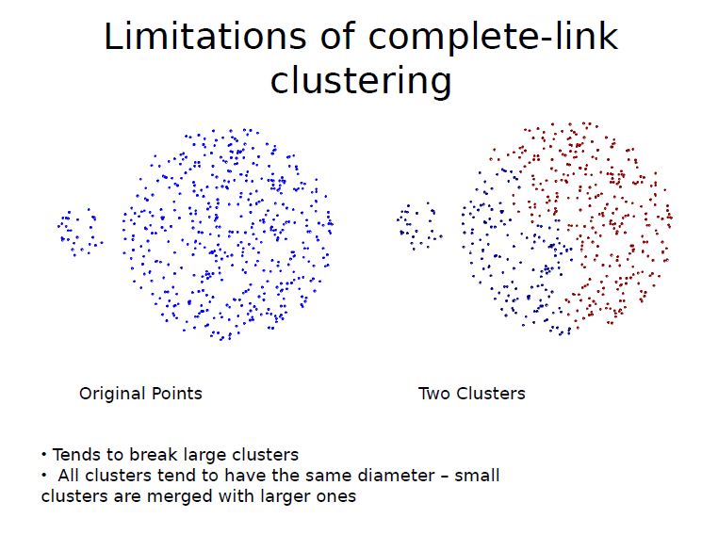

Slide 46
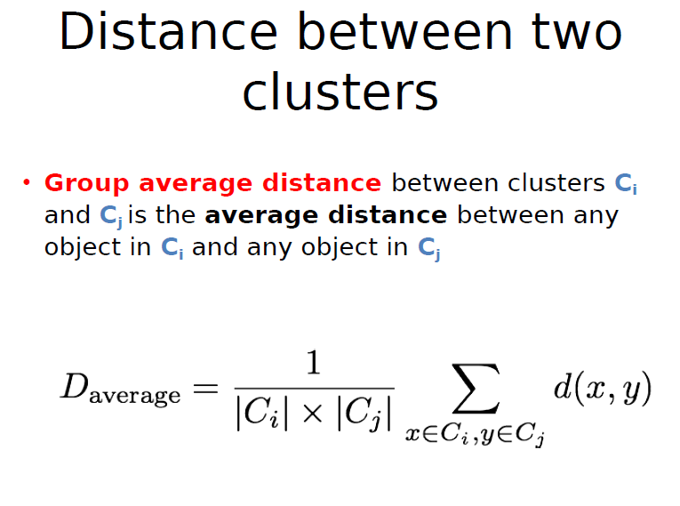

Slide 47
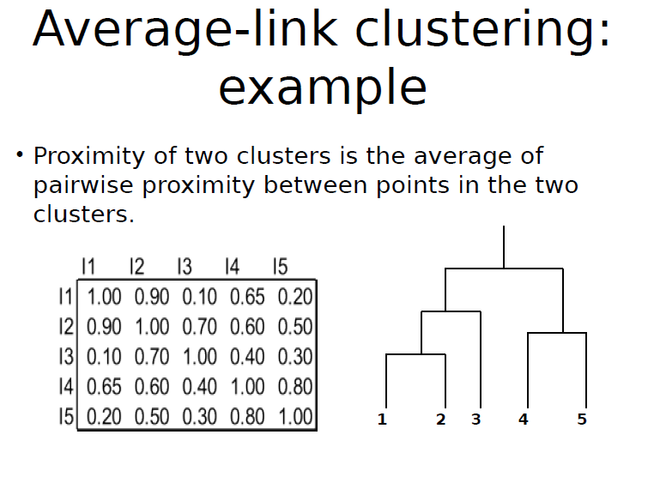

Slide 48
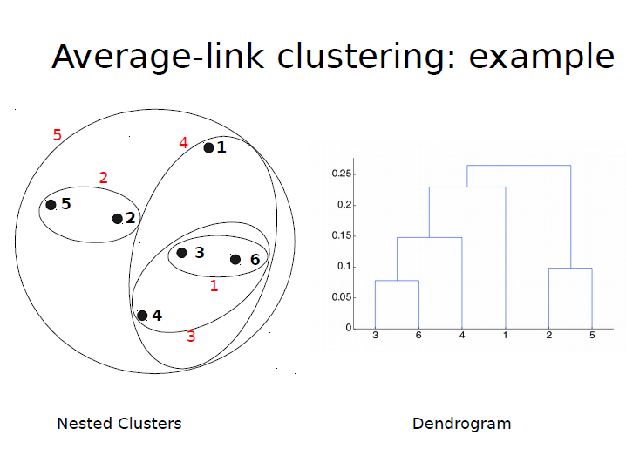

Slide 49
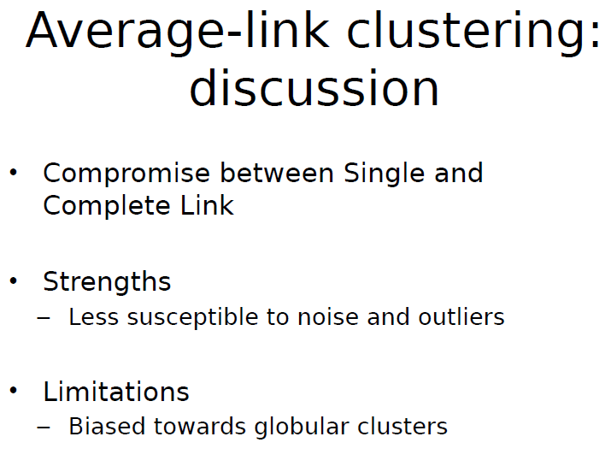

Slide 50
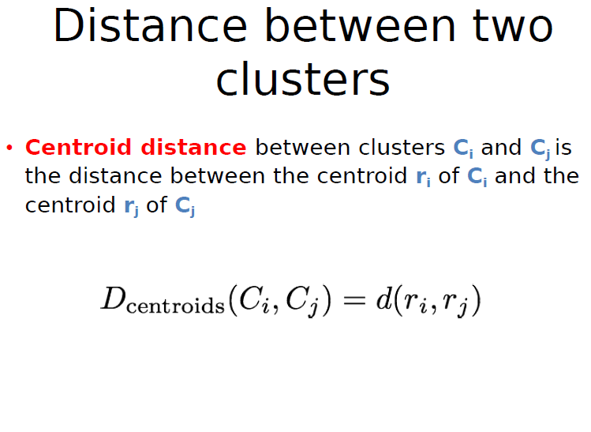

Slide 51
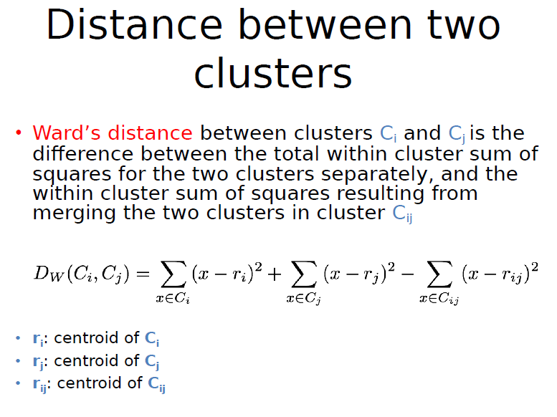

Slide 52
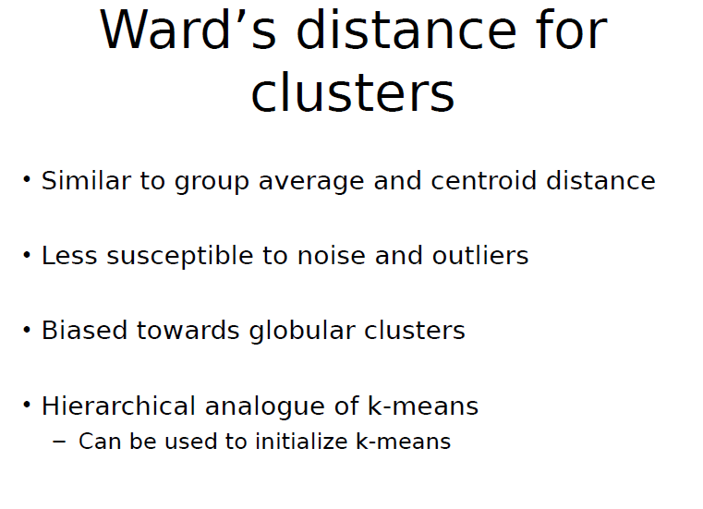

Slide 53
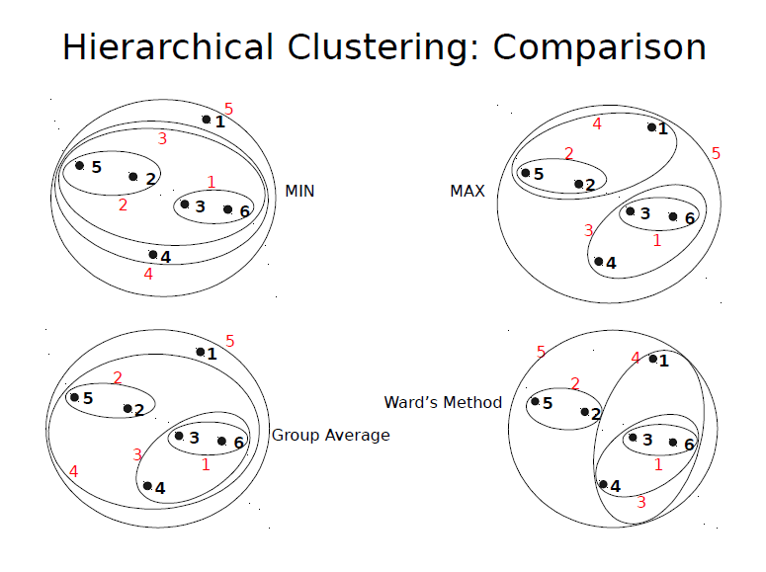

Slide 54
